Slide 1
Project Management Methodology
Project Management Process Groups
Project initiating – Define IT project

Slide 2
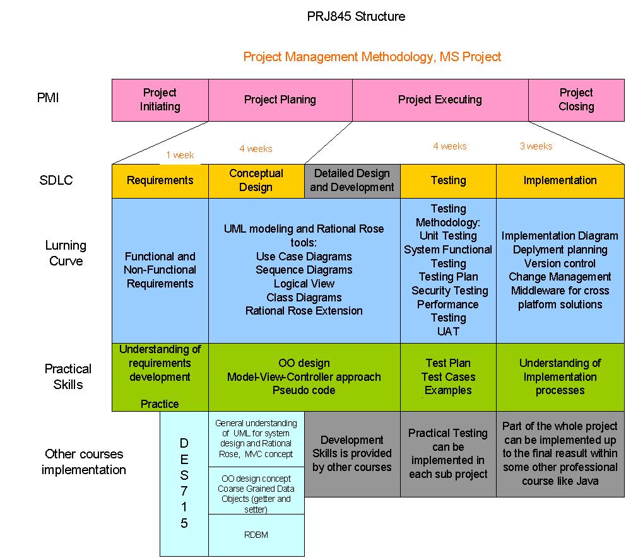
Putting it all together
Go to live
Project management processes:
- Initiating
- Planning
- Executing
- Monitoring and control
- Closing

Slide 3
Project management processes
Initiating
  Project definition and approval for development
Planning
  Develop plans for major project management activities
  Executing
  Coordinating people and other resources to produce the products

Slide 4
Project management processes
Monitoring and control
  Measure project progress against planned values or objectives
Closing
  Formalizing acceptance of the project, administrating activities to complete documentation, learned lessons, etc

Slide 5
Specifics of IT projects
Diversity of business requirements
  Custom development practically always required, resulting in project and system cost increased
Fast changing technology
  Project should not be long to keep pace with technology updates
  Pilot project often is required to evaluate new technologies

Slide 6
Specifics of IT projects
Work efforts are hard to estimate reliably
  Experience in system/software development is desirable for the IT project Manager
Globalization
  The need to learn different business and human cultures
  Differences in legal and security requirements
  Restrictions on import/export, technology solutions, etc.

Slide 7
Specifics of IT projects
Outsourcing
  Growing tendency to outsource parts of the project
  Effective vendor management is getting critical
  Increased business, technology, and security risks

Slide 8
Specifics of IT projects
Virtual teams and distributed development and production environments
  Different time zones impact negatively communication
  Increased security risks
  Increased project risks
  People management is more difficult
  More complicated technology infrastructure

Slide 9
Pre-project activities
System analysis
  Learn the results of system analysis performed by business people. This should bring understanding of how business, organization, and technology will be integrated into the product or service to be developed

Slide 10
Pre-project activities
Understand your organization (4 frames)
  Organization structure (see an organizational chart), different groups’ roles and responsibilities
  Human resource frame, in particular what skills are available
  Political frame. Know who will support and who will oppose your project
  Symbolic frame. Learn the culture of people, communication style and rules, dress code, etc.

Slide 11
Pre-initiating activities
Pre-initiating activities are performed by business departments or by management team and include-(Not necessarily in this order)
  Defining scope, time and cost constraints
  Define a Project sponsor
  Select a project manager (PM)
  Develop a business case
  Evaluate business risks
  Meet with the PM to discuss the project

Slide 12
Project Initiating activities
Define the project
Develop Project Charter document (Draft)
Identify stakeholders
Develop stakeholders registry and management strategy (basis of future communication plan)

Slide 13
Define the Project
Describe the project building blocks
  The project objectives
  Stakeholders
  Project success criteria
  Scope (In, Out)
  Project constraints (assumptions, pre-requisites)
  Deliverables
  Milestones
  Development team
  Estimated Project cost

Slide 14
Project objectives
It must be articulated from business perspectives (important point)
Statement that specifies technology solutions are allowed only to comment on how business objectives will be achieved

Slide 15
Stakeholders
Create a registry of stakeholders
It may include individuals or groups
Comment on their roles or how they are impacted by the project development
Define what kind of project information may be of interest for each stakeholder
Include contact information

Slide 16
Project success criteria
Basic criteria – to meet the constraints (scope, time, cost)
Additional criteria can be articulated to emphasize the project importance-for example business stakeholder (project sponsor) satisfaction

Slide 17
Project scope
Outline the project scope by specifying
  In scope
  Out of scope
Later you will describe the scope in more details
Try to minimize grey areas in your project scope

Slide 18
Project constraints
Identify project assumptions and dependencies
They may exist in regards to resource availabilities, or in regards to pre-requisites that should be setup at some point of time

Slide 19
Project Deliverables
Identify major project deliverables
Deliverables must be tangible
Any artifact can be considered as deliverables

Slide 20
Project Milestones
Identify major dates or points inside your SDLC when your major deliverables will be finished
That will be your milestones
Think about this from the perspective of reporting on the project progress

Slide 21
Project development team
Describe your human resource requirements
Use roles, not names
Specify skills required for each role

Slide 22
Estimated project cost
Project development cost should be estimated roughly (at a minimum) as part of the process of defining constraints

